Slide 1
Olist Store Ecommerce Analytics
P313
Group -3

Slide 2
Presented By-
Ankita Shelar
Nimisha P J
Girish Kharade
Shubham Tanawade
Chitransh Raikwar

Slide 3
Table of Content
1.Overview of Olist
2.Olist Business Model
3. Objectives
4. Tools Used
5. Pre- Processing Data
6. Dashboards
7. KPIs
8. Business Insights

Slide 4
Overview of Olist Store
Olist Store is a Brazilian ecommerce marketplace.
The dataset has information of 100k orders from 2016 to 2018 made at multiple marketplaces in Brazil.
The dataset has nine csv files.
Orders can be viewed from multiple dimensions: order status, price, payment and freight performance to customer location, product attributes and finally review score by customers.

Slide 5
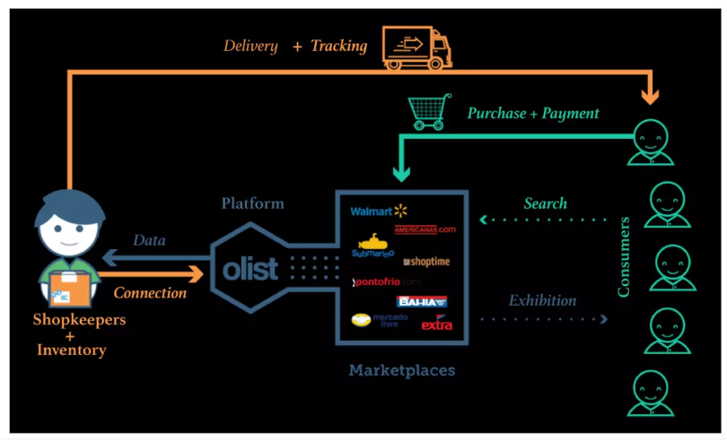
Olist Business Model

Slide 6
Objectives
Explore the company's product volume, sales, and customer satisfaction rating for products.
Analyze delivery performance.
Analyze product reviews.
Study the payment preferences by customers.
Find areas of improvement to generate more revenue.

Slide 7
Data Overview
olist_order_customer_dataset olist_order_dataset olist_order_reviews_dataset olist_order_payments_dataset olist_order_items_dataset olist_products_dataset olist_sellers_dataset olist_geolocation_dataset product_category_name_translation

Slide 8
Tools Used
Microsoft Excel
My SQL Workbench
Tableau
Microsoft Power BI

Slide 9
Pre-Processing Data
Data cleaning and transformation has been done using Microsoft Excel and Power Query Editor.
Nulls, blanks and duplicates have been removed.

Slide 10
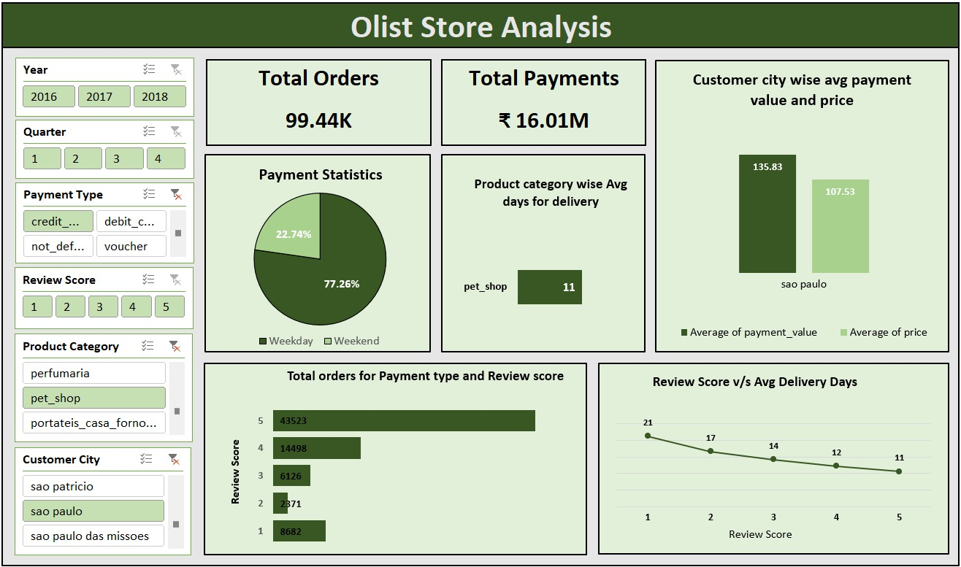
Excel Dashboard

Slide 11
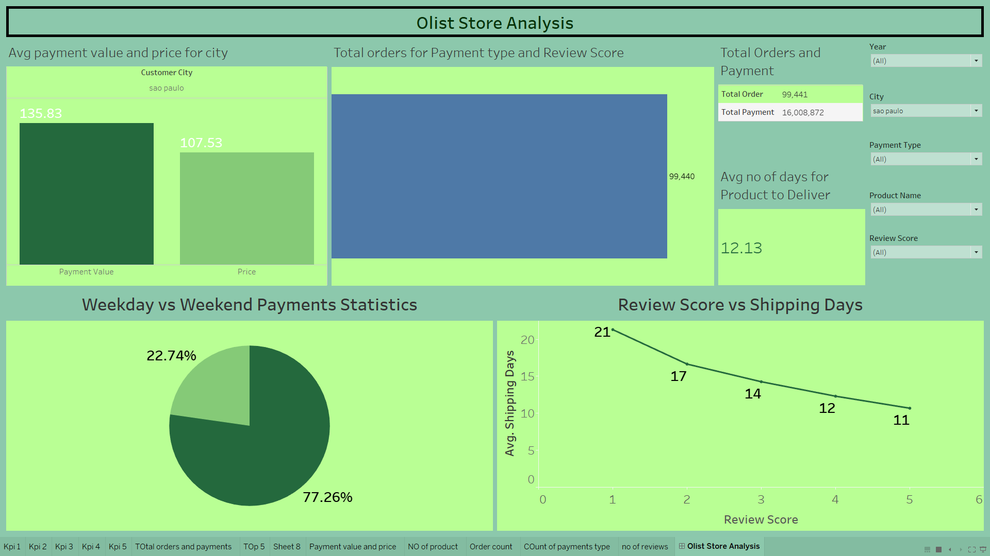
Tableau Dashboard

Slide 12
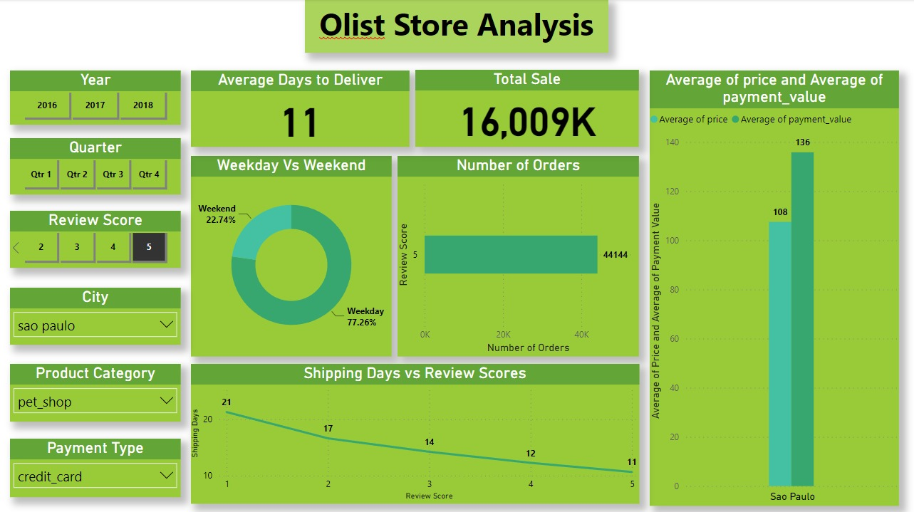
PowerBi Dashboard

Slide 13
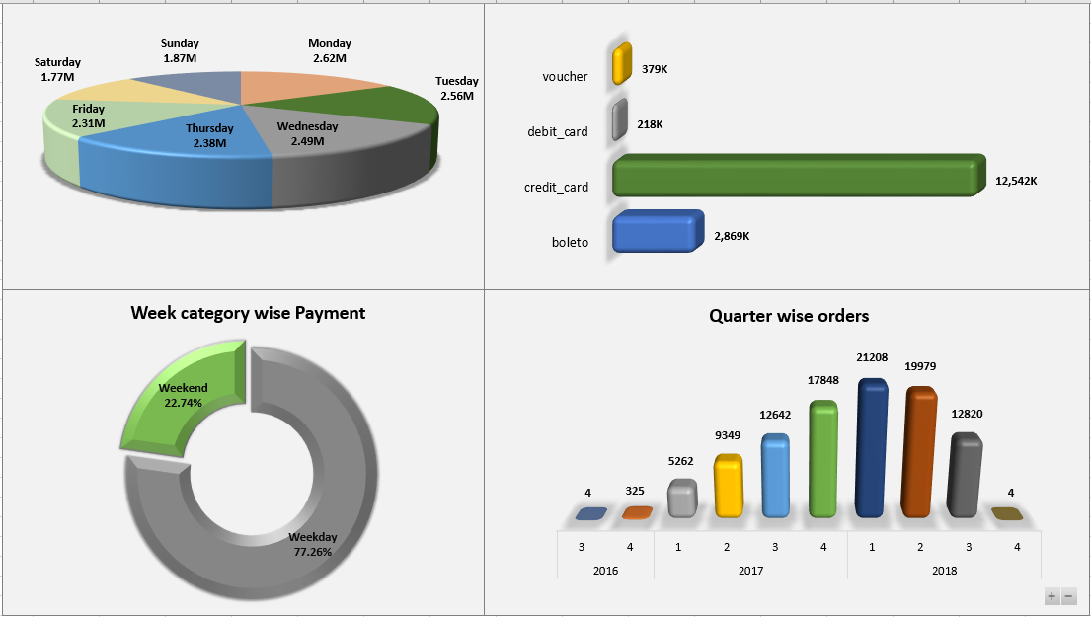
KPI 1 - Weekday Vs Weekend Payment Statistics
Analysis
Weekday sales and payments are more compared to weekend.
It Indicates relatively higher purchase of products on weekdays.
Gross sales are more on Mondays and lesser on Saturdays indicating people tend to purchase more on weekdays than weekends.

Slide 14
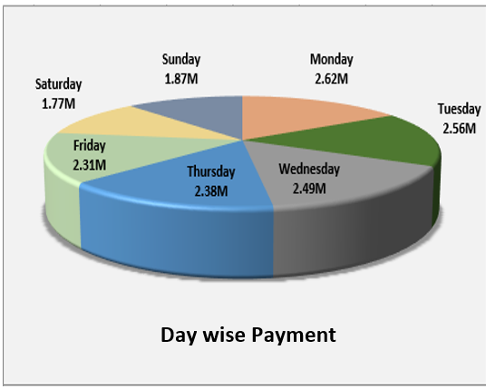
KPI 1 - Weekday Vs Weekend Payment Statistics
Suggestions
Increase stock of in demand products on weekdays more.
Provide some attractive offers on weekends to increase more sales.
Ensure faster delivery to improve sales on weekends.

Slide 15
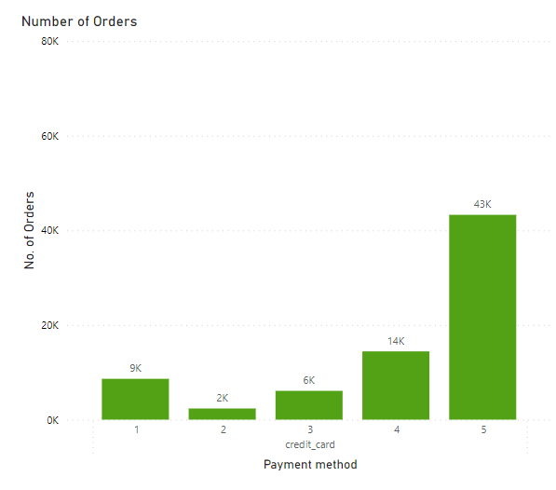
KPI 2- Number of Orders with review score 5 and payment type as credit card
Number of orders : 43k
Analysis:
Out of total orders , nearly more than 40% customers are fully satisfied with the product and shipping.
Payment using credit cards are hassle free thus encouraging more customers to use credit cards.

Slide 16
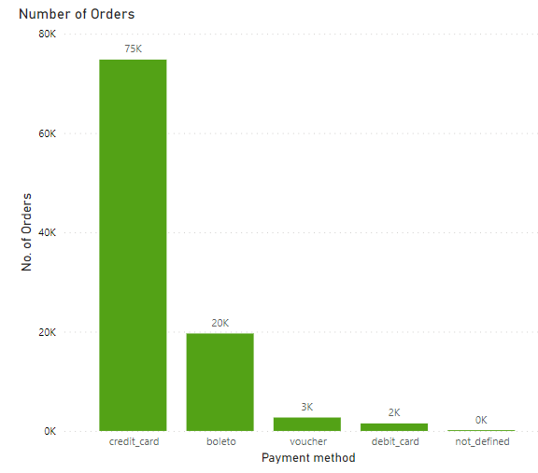
KPI 2- Number of Orders with review score 5 and payment type as credit card
Analysis:
Most preferred payment method is using credit card(>70%) followed by boleto(Cash payment).
Least preferred payment method is debit card.
Suggestions:
Identify satisfied customers .
Encourage them to make repeat purchases by providing gift cards, vouchers and offers.

Slide 17
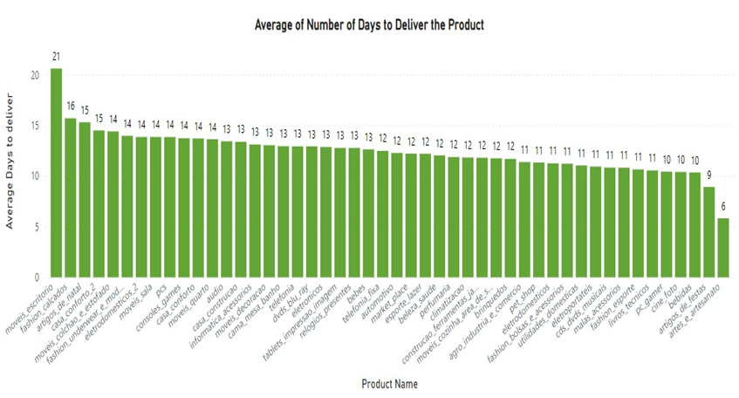
KPI 3- Average number of days taken for order delivery for pet shop

Slide 18
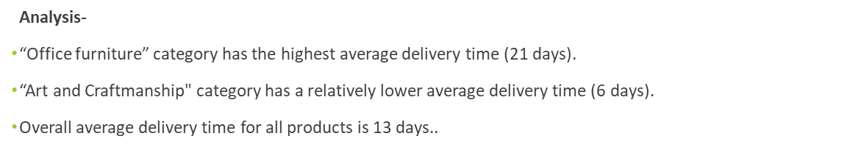
KPI 3- Average number of days taken for order delivery for pet shop
Suggestions-
Implement measures to optimize logistics and supply chain processes for the " Office furniture " category
Evaluate factors contributing to the shorter delivery time and apply them to other categories.
Address specific challenges such as transportation, handling, or inventory management contributing to the delay.

Slide 19
KPI 4- Average price and payment values from customers of Sao Paulo city
Average Payment Value - 135
Average Price - 108
Analysis-
Even if Sao Paulo and Rio De Janeiro have high payment value , Pianco is the city who got highest payment values in terms of average.
Suggestions-
In order to increase the average payment value and price, we have to focus on increasing payment value and price for every single order.
We can give more suggestions of product before customer is about to place order to increase purchase.
Average Payment Value
Average Price
135
108

Slide 20
KPI 5- Relationship between shipping days Vs review scores.
Review score 5 :- 11 days
Review score 1 :- 20 days
Analysis-
Higher review score indicates lesser number of average shipping days
and vice-versa.
Suggestions-
We have to reduce the shipping days by working on logistics management
to improve customer satisfaction and thus reviews.
21
17
14
11
12
5
4
3
2
1
Review Score

Slide 21
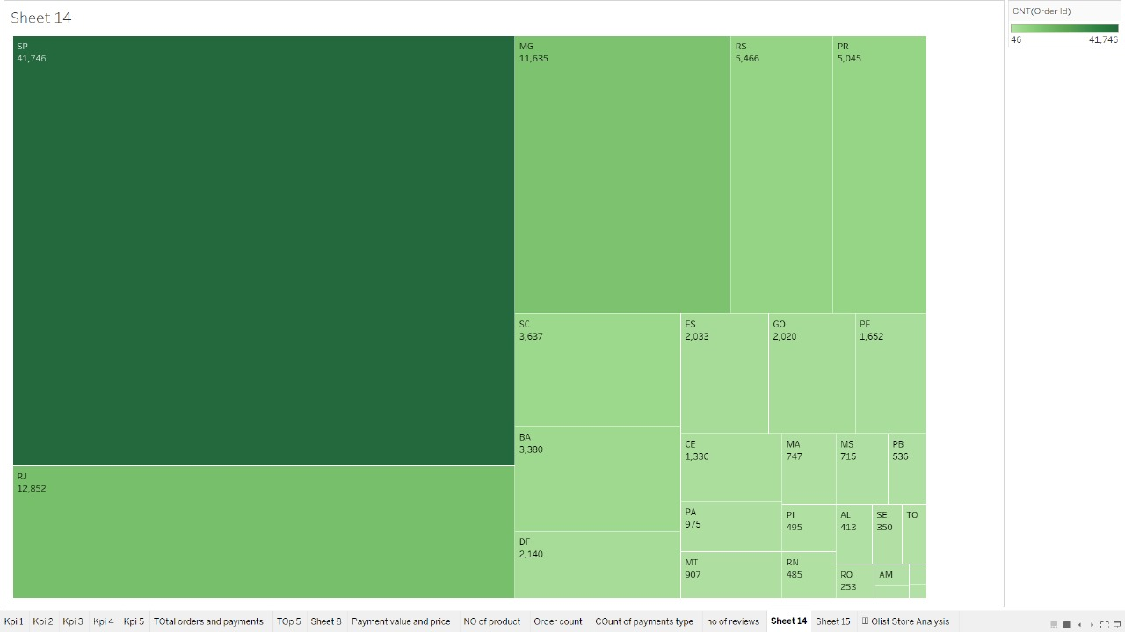
Business Insights
Pianco is the city with highest average payment value(2325) and average price(2200).
Top 5 states with highest payment value are :
Sao Paulo & Rio De Janeiro has highest payment values about 2.2M & 1.1M.
Rio De Janeiro (zip code - 22790) has highest numbers of orders.

Slide 22
Business Insights
Most preferred way to pay the bills is – CREDIT CARD.
Gross Sales on weekdays is more than on weekends.
1) SP | 2) RJ | 3) MG | 4) PR | 5) RS

Slide 23
Business Insights
Top 5 selling products are :
As these are top selling products no of reviews are also high for there products.
We can say that business over year has grown because payment value over year has increased significantly.
1) Bed bath table | 2) Health beauty | 3) Sports Leisure | 4) Computer accessories | 5) Furniture decor

Slide 24
Business Insights
We can see significant increase in growth and popularity of olist store over past years.
The sales for 1st and 2nd quarters of year 2018 are maximum.

Slide 25
Conclusion
Implement personalized marketing campaigns.
Increase social media engagement.
Introduce Gift Card to Regular Customers.
Gather feedback for continuous improvement.
Explore collaborations with sellers and brands for wider customer range.
Focus on areas with poor logistic and supply chain management.
Introduce limited-time offers to grab more customers.
Develop targeted email campaigns in lower sales area.
Highlight customer reviews for trust-building.

Slide 26


